Slide 1
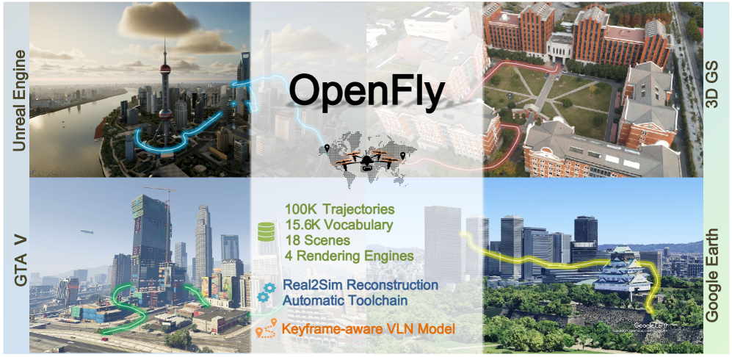
OpenFly: A Comprehensive Platform for Aerial Vision-Language Navigation
Dr. Peng Jiang Lab
Presented by: Dev Patel
Computer Science in Artificial Intelligence

Slide 2
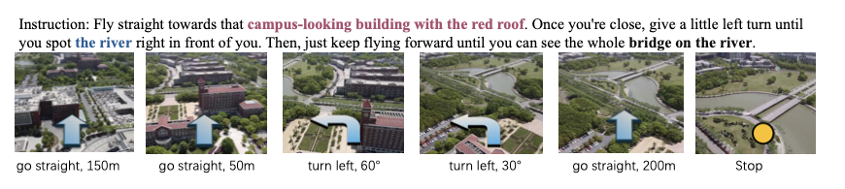
1.) Introduction
Vision Language Navigation (VLN): The Task of guiding agents using natural language instructions and visual observations.
Aerial VLN with UAVs remains underexplored despite real-world importance
To address these limitations, the authors propose OpenFly

Slide 3
2.) Objectives
OpenFly Platform: Integration of multiple rendering engines (Unreal Engine, GTA V, Google Earth, 3D Gaussian Splatting).
Automated Toolchain: Streamlined pipeline for point cloud acquisition, semantic segmentation, trajectory generation, and instruction generation.
OpenFly-Agent Model: A keyframe-aware VLN model that emphasizes critical observations and reduces redundancy through visual token merging.
Comprehensive Benchmarking: Extensive experiments comparing recent VLN methods, showing superior performance and strong real-to-sim generalization

Slide 4
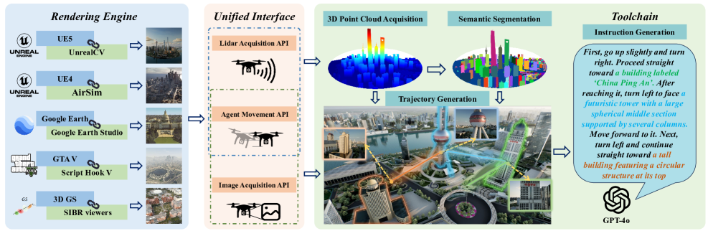
3.) Methodology-Data Collection

Slide 5
4.) Unified Interface
Agent Movement Interface
CoorTrans module: unifies all engine coordinates to meter-based FLU (Front-Left-Up)
Precise positioning → consistent, automatic trajectory generation across scenes.
Lidar Data Acquisition Interface
Supports multiple LiDAR sources: real sensor, depth back-projection, image feature matching
All LiDAR aligned to the same FLU system via CoorTrans.
Image Acquisition Interface
Unified HTTP RESTful + TCP/IP request layer
Pull images from any pose, with flexible resolution & viewpoint

Slide 6
5.) Automated Toolchain
Point Cloud Acquisition:
Rasterized sampling (Unreal Engine, GTA V).
Sparse reconstruction (3D Gaussian Splatting)
Scene Semantic Segmentation:
Octree-Graph for 3D scene understanding.
Point cloud projection + contour extraction
Optional manual annotation for refinement
Automatic Trajectory Generation:
Builds global voxel map (Mglobal).
Chooses landmarks + start/end points.
Uses A* pathfinding for collision-free UAV paths.
Instruction Generation:
Keyframe extraction at action changes.
Sub-trajectory segmentation → GPT-4o generates sub-instructions.
Sub-instructions fused into full trajectory description.
Post-processing with NLTK + embeddings to remove redundancy

Slide 7
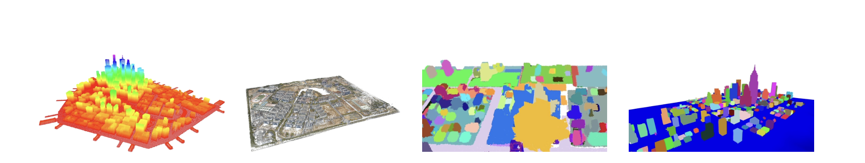
6.) 3D GS Data Collection
(a)
(b)
(c)
(d)
(a) Rasterized sampling point cloud reconstruction.
(b) Image-based point cloud reconstruction.
(c) Semantic 3D scene segmentation.
(d) Point cloud projection and contour extraction.

Slide 8
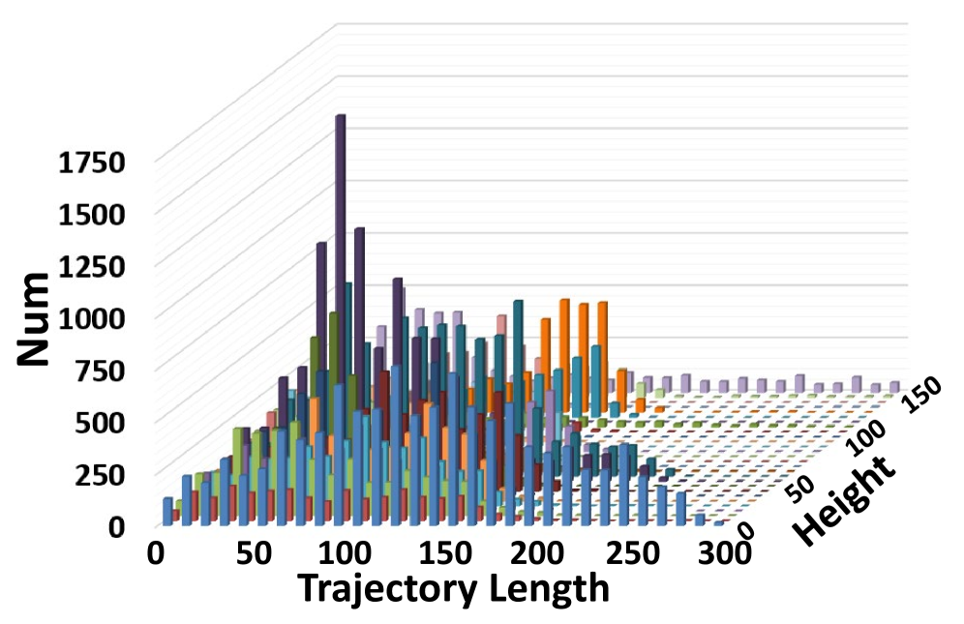
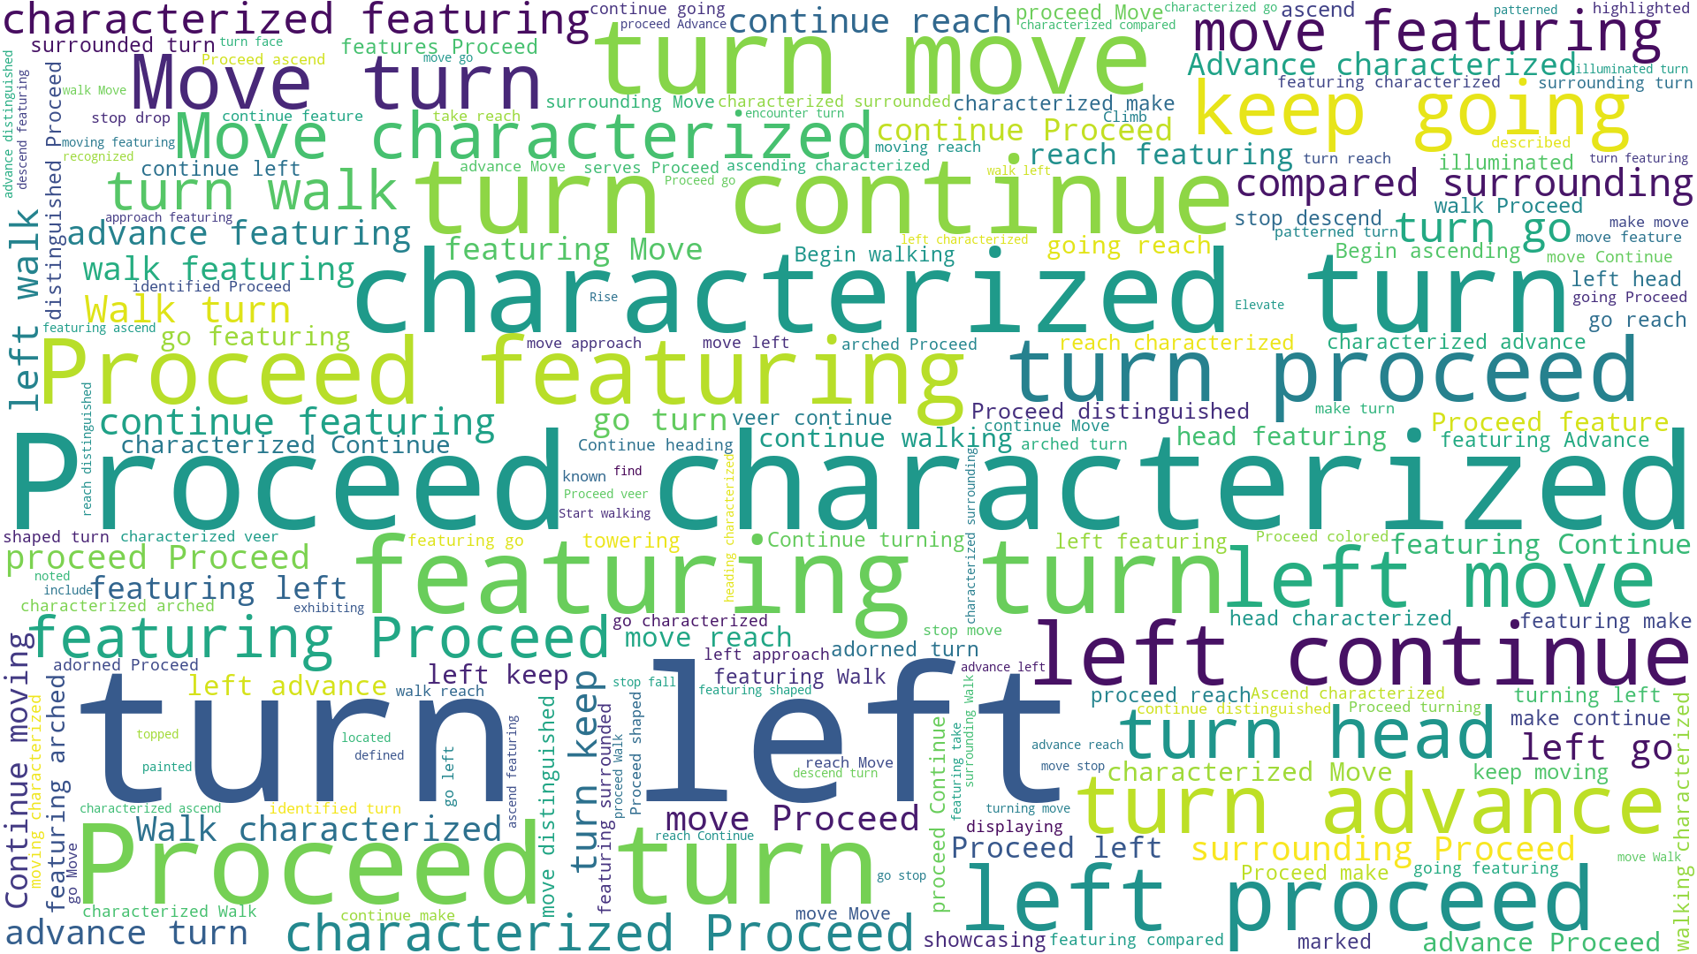
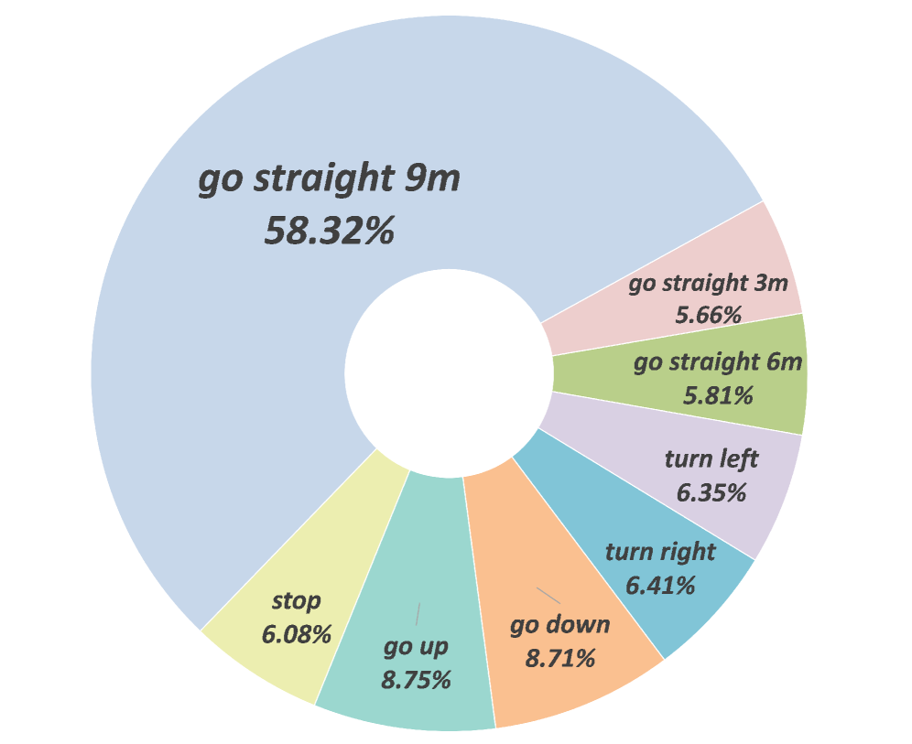
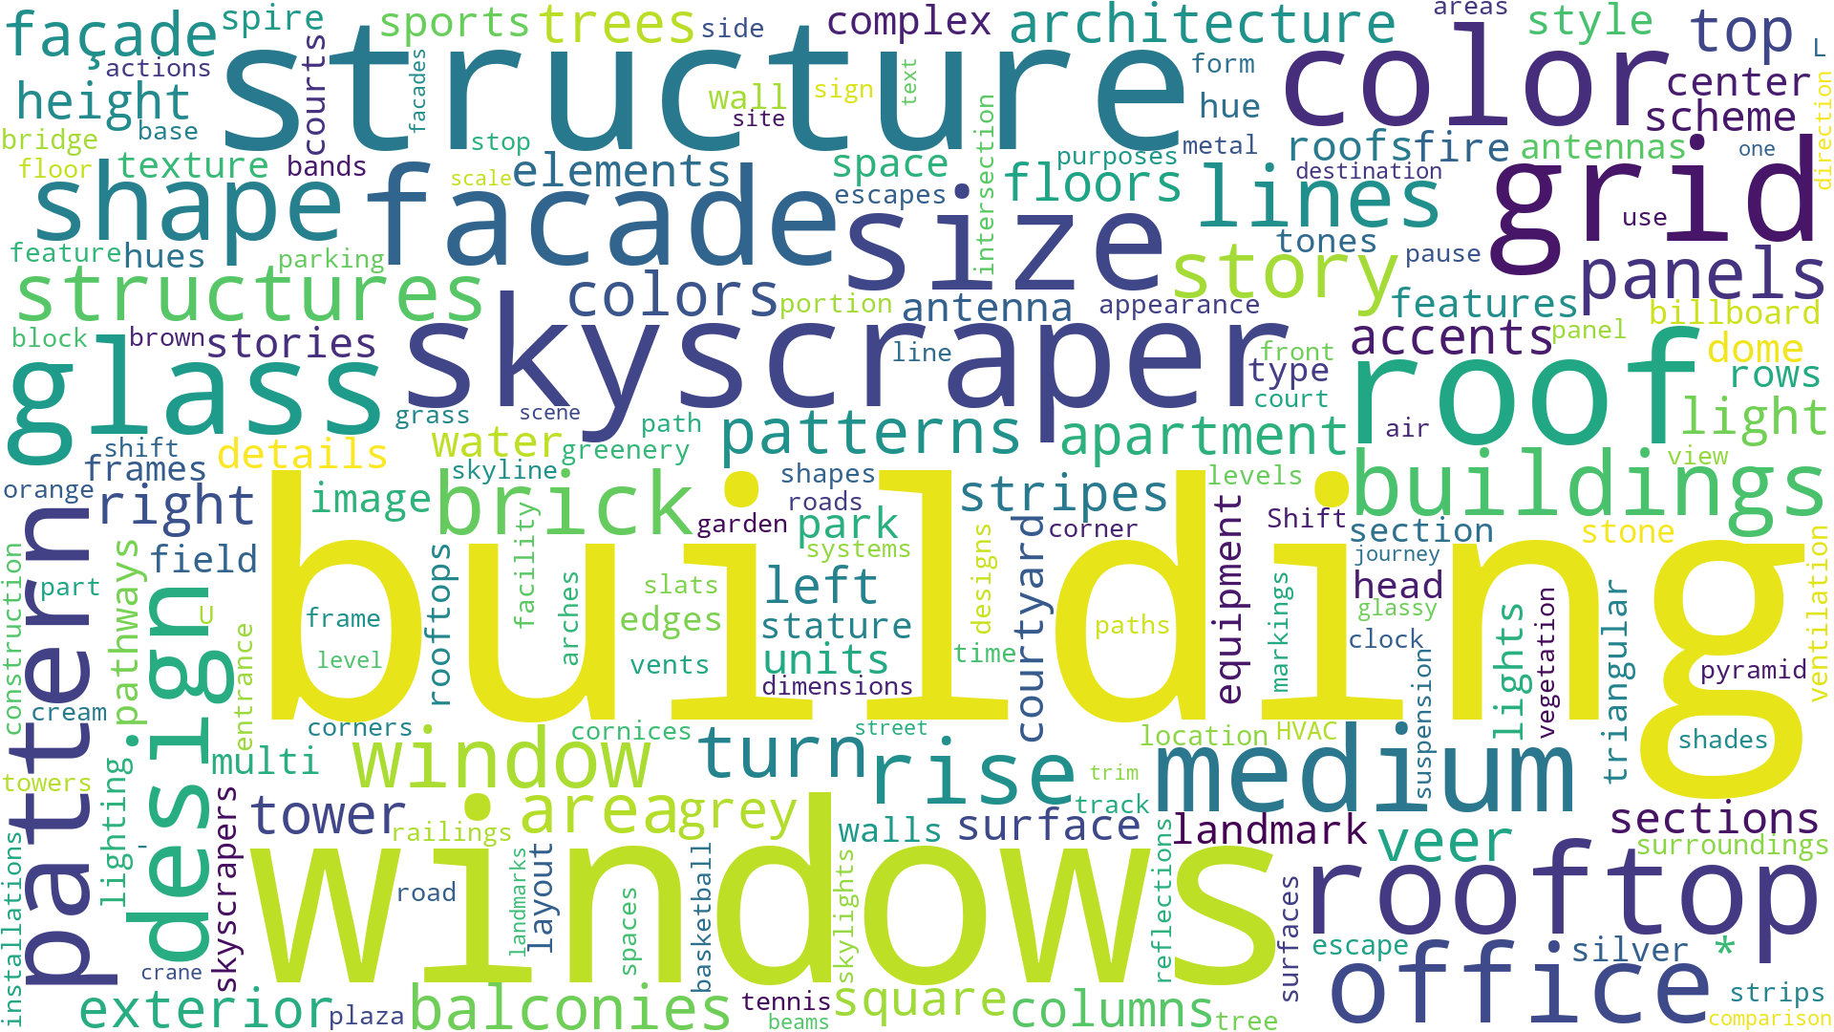
7.) Dataset Analysis
Trajectory and Instruction Analysis
Dataset Scale
100K UAV trajectories → largest among VLN datasets
Trajectory Distribution
Lengths: 0 – 300 meters
Heights: 0 – 150 meters
Action Representation
Discrete actions: {Forward, Turn Left, Turn Right, Ascend, Descend, Stop}
Use 3 granularities of Forward.
Instruction Analysis
Vocabulary size: 15.6K unique words
Average instruction length: 59 words
Frequent nouns: building, windows, skyscraper
Frequent verbs: proceed, turn
Length and height distributions of trajectories.
Word cloud of verbs.
Action distributions
Word cloud of nouns

Slide 9
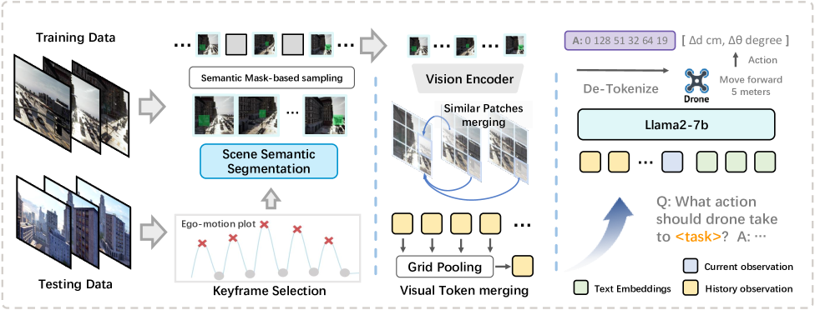
8.) OpenFly Agent
Inputs: image sequence (current frame + short visual history), natural-language instruction
Keyframe Selection: Captures crucial frames during action transitions
Visual Token Merging: Compresses redundant observations across frames
Architecture: Vision encoder (DINO-SigLIP) + Llama2-7B language model
Actions: {Forward, Turn Left, Turn Right, Ascend, Descend, Stop}

Slide 10
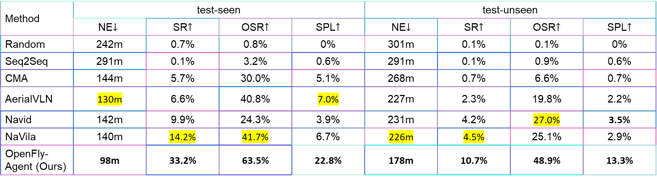
9.) Results & Discussion
Evaluation Metrics
Navigation Error (NE) ↓
Success Rate (SR) ↑
Oracle Success Rate (OSR) ↑
Success weighted by Path Length (SPL) ↑
Benchmark Performance
OpenFly-Agent outperforms baselines (Seq2Seq, CMA, AerialVLN, Navid, NaVila)
Seen Environments: SR = 33.2% vs. <15% for others
Unseen Environments: SR = 10.7% (better generalization, still challenging)
Method | test-seen |  |  |  | test-unseen
 | NE$↓$ | SR$↑$ | OSR$↑$ | SPL$↑$ | NE$↓$ | SR$↑$ | OSR$↑$ | SPL$↑$
Random | 242m | 0.7% | 0.8% | 0% | 301m | 0.1% | 0.1% | 0%
Seq2Seq | 291m | 0.1% | 3.2% | 0.6% | 291m | 0.1% | 0.9% | 0.6%
CMA | 144m | 5.7% | 30.0% | 5.1% | 268m | 0.7% | 6.6% | 0.7%
AerialVLN | 130m | 6.6% | 40.8% | 7.0% | 227m | 2.3% | 19.8% | 2.2%
Navid | 142m | 9.9% | 24.3% | 3.9% | 231m | 4.2% | 27.0% | 3.5%
NaVila | 140m | 14.2% | 41.7% | 6.7% | 226m | 4.5% | 25.1% | 2.9%
OpenFly-Agent (Ours) | 98m | 33.2% | 63.5% | 22.8% | 178m | 10.7% | 48.9% | 13.3%

Slide 11
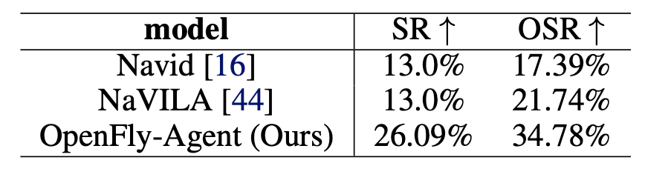
10.) Results & Discussion
Real-World UAV Tests
Success Rate = 26.1%, OSR = 34.8%
Strong evidence of sim-to-real transfer

Slide 12
11.) Limitations
Model Practicality
OpenFly-Agent built on large VLMs (e.g., Llama2-7B)
High computational cost → not suitable for real-time UAV deployment
Generalization Challenge
Noticeable performance gap in unseen environments
Highlights the difficulty of adapting to novel aerial scenes

Slide 13
12.) Future Work
Lightweight & Efficient Models
Develop smaller VLM architectures for real-time UAV deployment
Explore quantization, pruning, and distillation techniques
Better Generalization
Improve performance on unseen environments
Leverage domain adaptation and sim-to-real transfer strategies
Expanded Applications
Extend OpenFly to multi-agent UAV tasks (e.g., cooperative search)
Integrate with real-world UAV platforms for practical deployment

Slide 14
13.) Summary
While OpenFly makes important contributions, there are some limitations. First, although 3D Gaussian Splatting improves realism, in very large-scale reconstructions it still produces artifacts, which can affect navigation quality.
Second, the proposed OpenFly-Agent is built on large vision-language models. This design achieves strong accuracy but comes with a high computational cost, making it impractical for real-time UAV deployment without optimization.
Finally, the results show a significant performance drop in unseen environments, which highlights the ongoing challenge of generalization in aerial VLN. Addressing this gap will be crucial for real-world adoption.

Slide 15
14.) Take Away
OpenFly fills the gap in aerial VLN with the largest, most diverse benchmark
Automated toolchain makes data collection scalable and efficient
OpenFly-Agent shows how keyframe awareness + token merging improve UAV navigation
Strong sim-to-real transfer → step toward practical UAV applications
Establishes a foundation for future research in aerial embodied AI

Slide 16
Thank You!
Questions.?

